Slide 1
Cooling Channel Geometry Analysis for a Regeneratively Cooled Rocket Engine
Zoe Brand
Mentor: Dr. Elliott Bryner
Arizona Space Grant Symposium
April 17, 2021

Slide 2
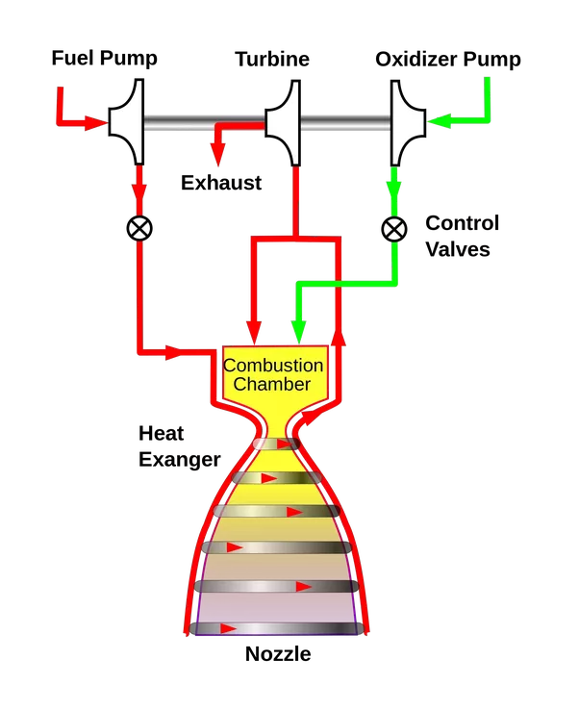
Assist future development of regeneratively cooled rocket engines at Embry Riddle
Regeneratively Cooled Rocket Engine-
liquid rocket engine that cools the nozzle by running its own fuel around the chamber and/or nozzle
Source: stars.library.ucf.edu

Slide 3
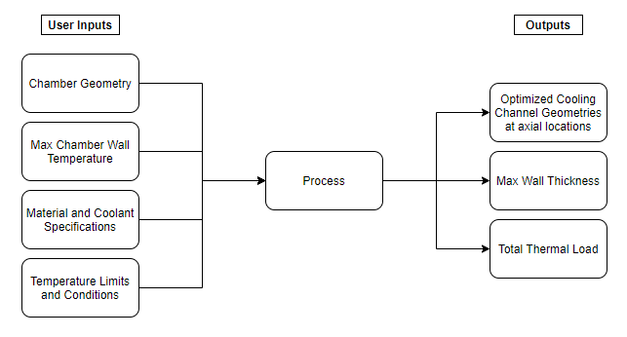
Develop a mathematical model to simulate effective cooling by changing cooling channel geometries

Slide 4
Cooling channel geometries will vary axially based on changing aspect ratio
Source: https://www.researchgate.net/figure/Geometric-parameters-for-the-cooling-channels_fig1_43654987

Slide 5
A verification test will be completed to ensure correct heat transfer correlations

Slide 6
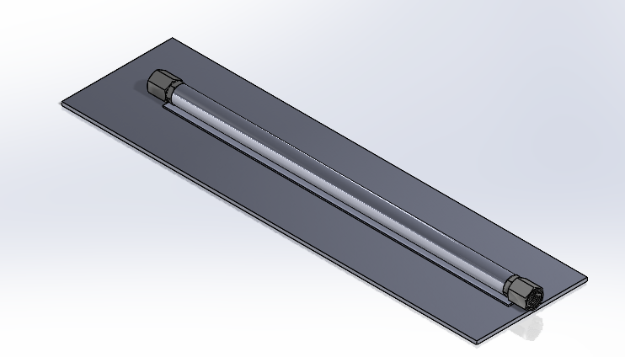
Single cooling channel test to validate mathematical model

Slide 7
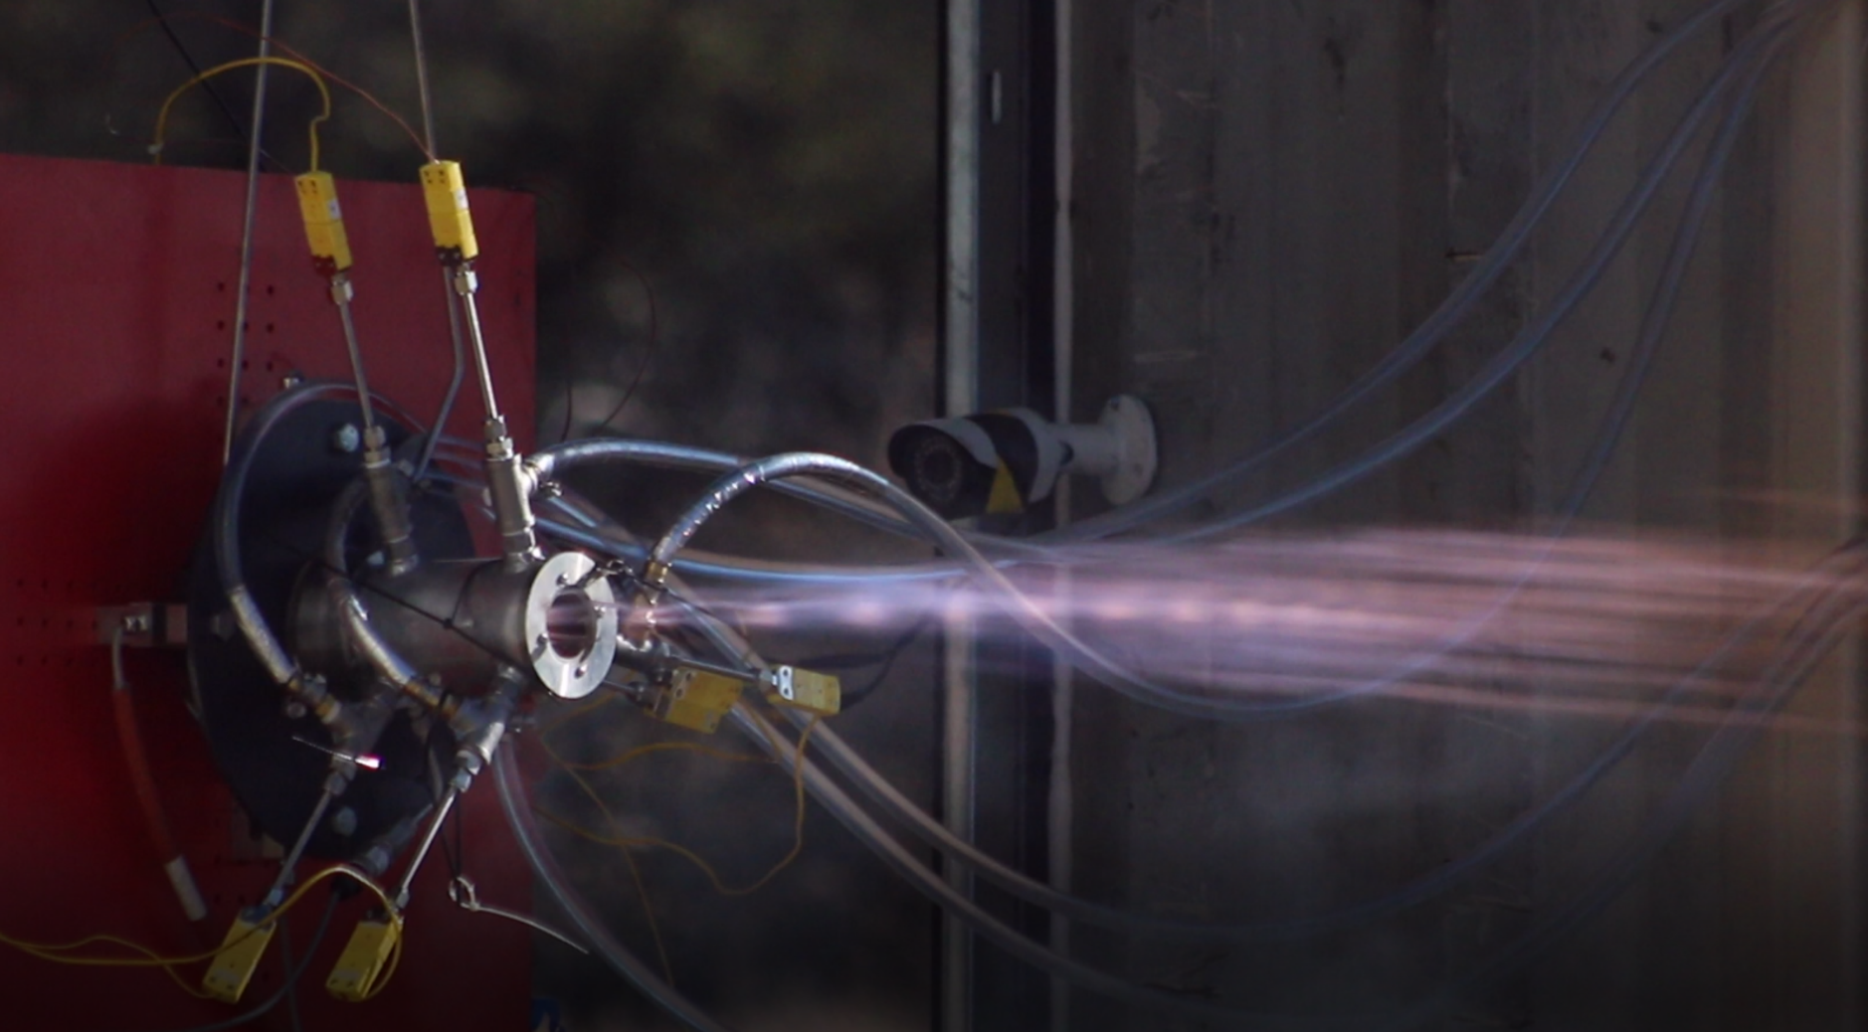
Moving forward, the mathematical model will provide a simulation to start regeneratively cooled engine design at Embry Riddle

Slide 8
Acknowledgements
Dr. Elliott Bryner- for his mentorship in this research
Embry-Riddle Aeronautical University- for use of facilities and resources
Rocket Development Lab- for mentorship and resources

Slide 9
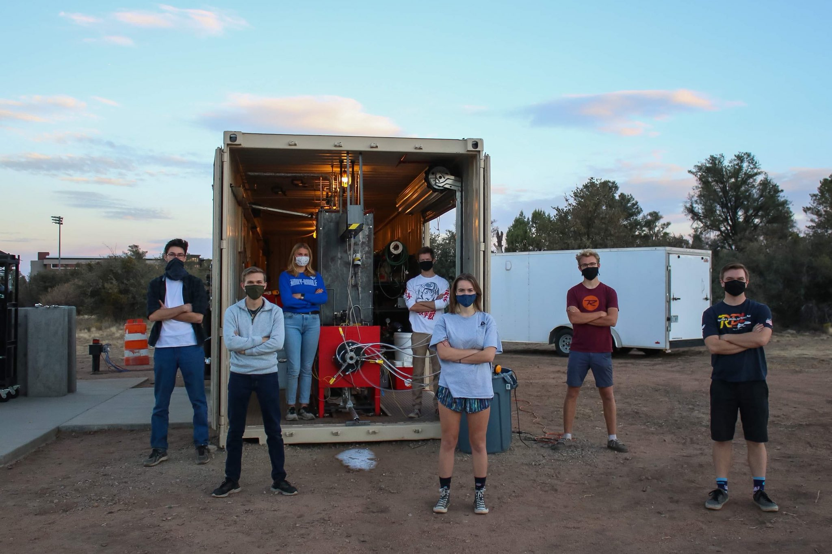
Questions?
Thank you

